Slide 1
Mapping London’s crime with R and Shiny web applications and clustering areas of similar crimes using Self-Organising Maps (SOMs)

Slide 2
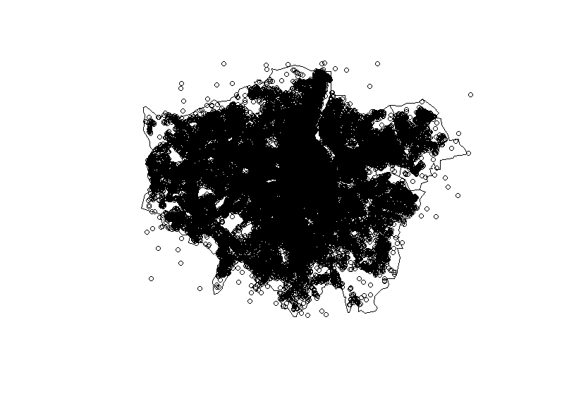
GIS in R
Plotting all crimes in London

Slide 3
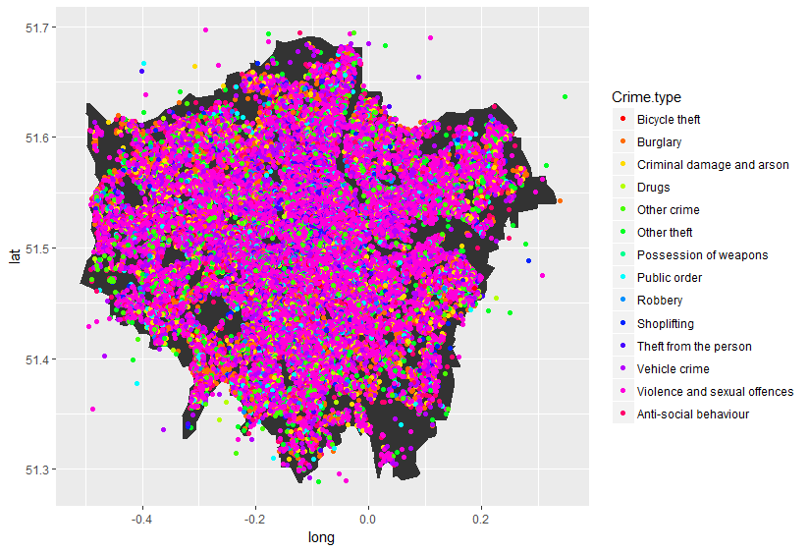
Lets differentiate between the various types of crime

Slide 4
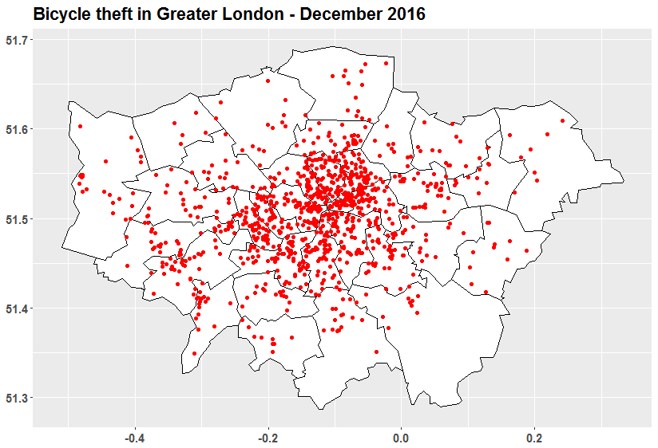
Easier to visualise one type of crime

Slide 5
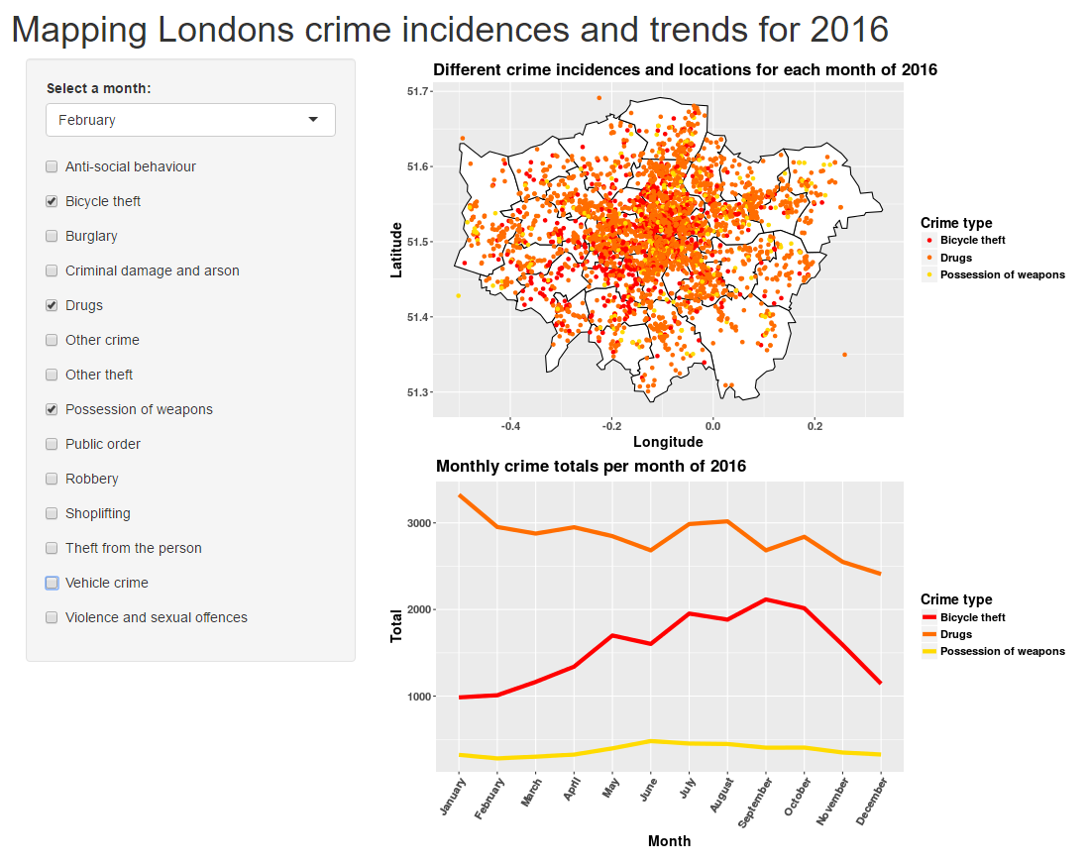
Turn it into a Shiny application
Toggle crimes and select different months.
View each crimes trend by month over the year

Slide 6
Self-Organising Maps
Segmentation of areas by types of crime

